Slide 1

contact@softyeducation.com

Slide 2
Day 11

Slide 3
Content :
What is Recursion?
Recursive Example: Factorial
Recursive Example: Fibonacci Sequence
Exercises

Slide 4

01
What is Recursion?

Slide 5

01- What is Recursion?
Recursion is a fundamental concept in computer science and programming. In essence, recursion is when a function calls itself. It's a useful tool for breaking down complex problems into simpler, more manageable tasks.
‹#›

Slide 6
01- What is Recursion?
At its heart, recursion is the process of defining something in terms of itself. In the realm of programming, a recursive function is one that calls itself to solve a problem.
‹#›

Slide 7
01- What is Recursion?
Base Case and Recursive Case
Two essential parts of a recursive function are:
Base Case: This stops the recursion. Without it, the function would call itself indefinitely, leading to a stack overflow.
Recursive Case: This is where the function calls itself.
‹#›

Slide 8
Recursive Example: Factorial
02

Slide 9
02 - Recursive Example: Factorial
The factorial of a number n (denoted as n!) is the product of all positive integers less than or equal to n. For example:
5!=5×4×3×2×1=120
In terms of recursion:
n!=n×(n−1)!
0!=1 (This is the base case)
‹#›

Slide 10
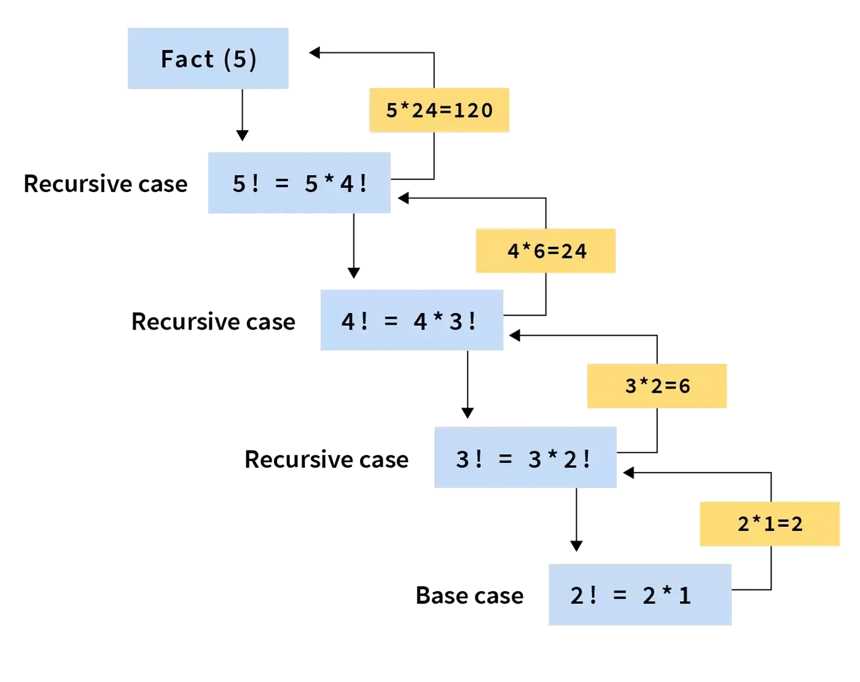
02 - Recursive Example: Factorial
‹#›

Slide 11
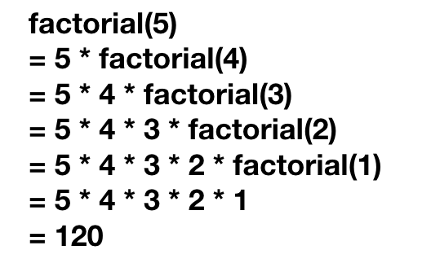
02 - Recursive Example: Factorial
‹#›

Slide 12
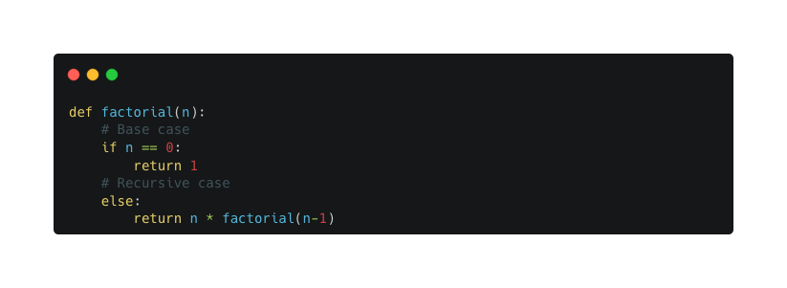
02 - Recursive Example: Factorial
Let's implement this in Python:
‹#›

Slide 13
Recursive Example: Fibonacci Sequence
03

Slide 14
03 - Recursive Example: Fibonacci Sequence
The Fibonacci sequence is a series of numbers where each number is the sum of the two preceding ones, typically starting with 0 and 1:
0,1,1,2,3,5,8,13,...
The sequence can be defined recursively:
fib(n)=fib(n−1)+fib(n−2)
fib(0)=0,fib(1)=1fib(0)=0,fib(1)=1 (These are the base cases)
‹#›

Slide 15
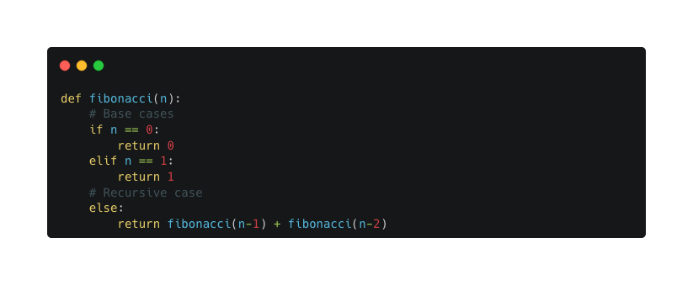
03 - Recursive Example: Fibonacci Sequence
Python implementation:
‹#›

Slide 16
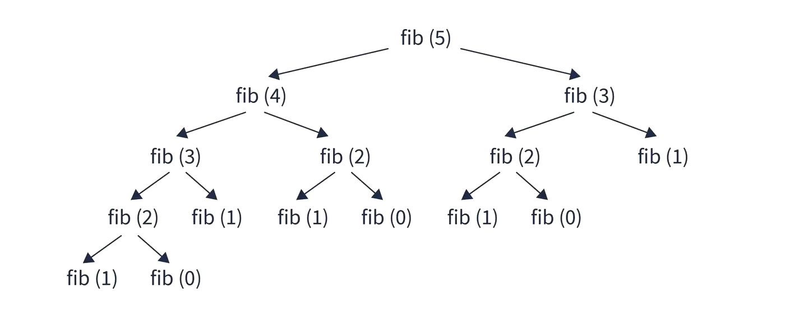
03 - Recursive Example: Fibonacci Sequence
‹#›

Slide 17
04
Exercises

Slide 18
04 - Exercises
Sum of Natural Numbers:
Write a recursive function to find the sum of natural numbers up to n.
For example, if the input is 5, the function should return 15 because 1+2+3+4+5=151+2+3+4+5=15.
‹#›

Slide 19
04 - Exercises
2. Count Digits:
Write a recursive function to count the number of digits in a positive integer.
For instance, if the input is 1054, the function should return 4.
‹#›

Slide 20
04 - Exercises
3. Reverse a String:
Implement a recursive function to reverse a given string.
E.g., for the input string "python", the output should be "nohtyp".
‹#›

Slide 21
Thank you

